Slide 1


Web Application on Cloud

Slide 2



Course : Mastering DevOps
Lecture On : Web Application on Cloud
Instructor: Dipesh Garg

Slide 3

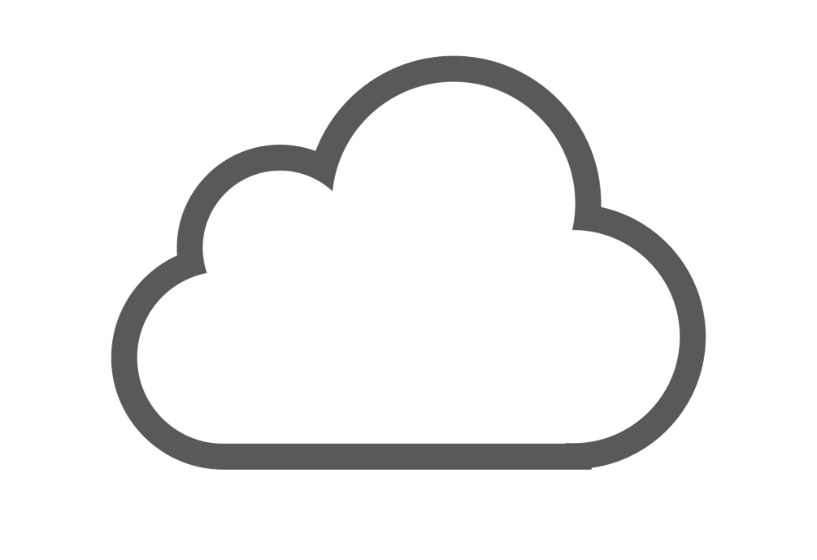

WEB APPLICATION ON THE CLOUD
Introduction to
Web Applications
Application Architectures
Scaling and Load Balancing

Slide 4
Web Application

Slide 5
SESSION OVERVIEW: INTRODUCTION TO WEB APPLICATIONS
What Is a
Web Application?
Three-Tier structure of a Web Application
Web Servers Apache HTTP & Tomcat
Architecture of a
Web Application
Brief introduction
How a web application works
Benefits of using a web application
Website vs web application
Commonly used web applications
Overview of the one-tier and two-tier architectures
Three-tier architecture and its layers
Benefits of using the three-tier architecture
N-tier architecture
What is a web server?
Need for web servers
How it works
Apache HTTP server
Tomcat server
Working of the Apache web server
Difference between the Apache HTTP and Tomcat servers
Other web servers: Windows IIS and Nginx
Monolithic architecture
Service-oriented Architecture
Microservice architecture
Advantages and disadvantages of using microservice architecture
Difference between monolithic and microservice architecture
Use case: Uber
Brief introduction to microservice tools
Serverless architecture

Slide 6
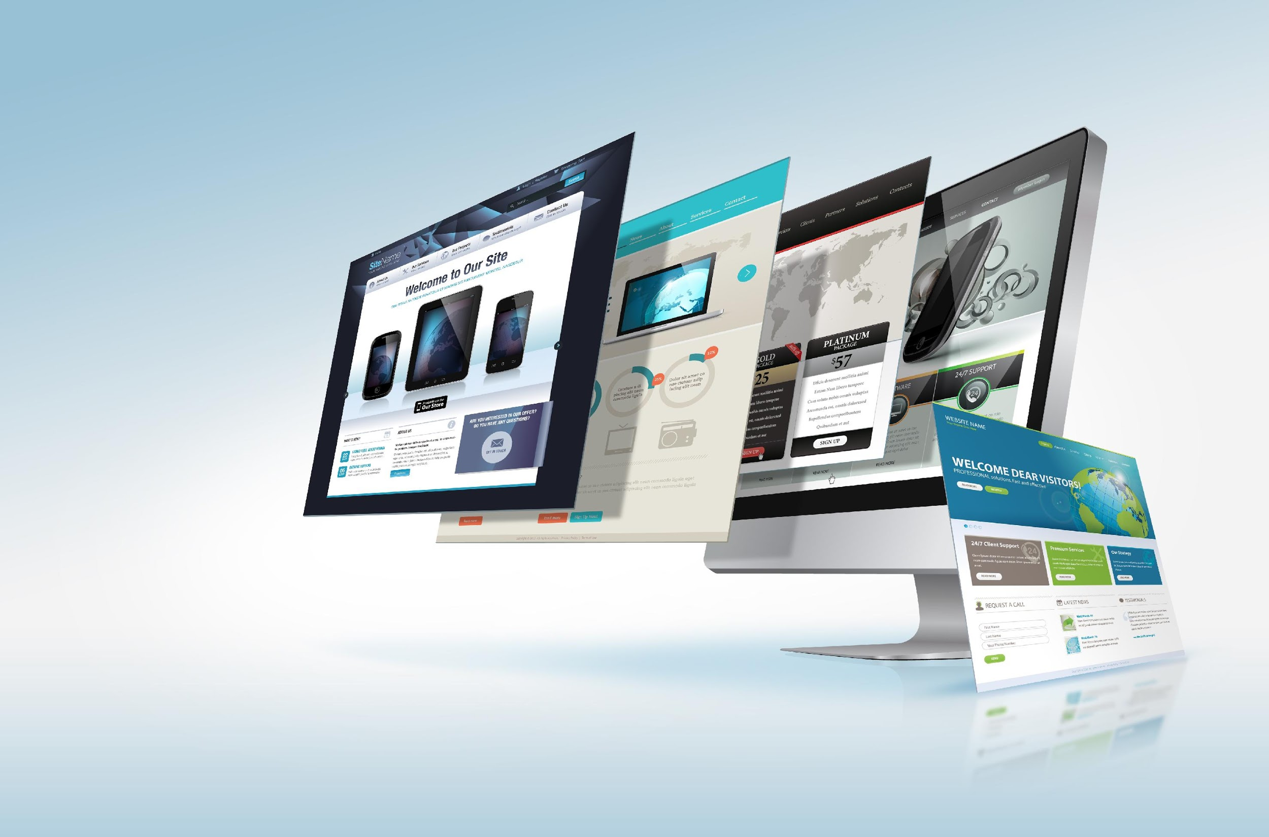
What Is a
Web Application?

Slide 7
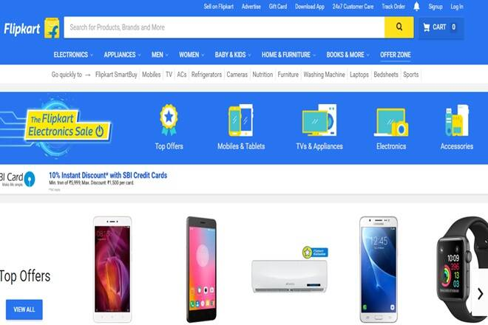

BRIEF INTRODUCTION
It is a computer program that uses a web browser and web technology to perform any task over the Internet.
Example: Flipkart, BookMyShow

Slide 8
DIFFERENCE
Web Application
Website
It is designed for interactions with end users
The user can read the content of web applications and manipulate the data
It is client-server based
It mostly requires users to sign up/log in
Example: Amazon, Facebook, etc.
It contains static content. It is publicly accessible to all users
The user can read its contents but not manipulate or affect its functioning
It is server based
It is meaningless to have users log into a website
Example: Breaking News, Aktu

Slide 9
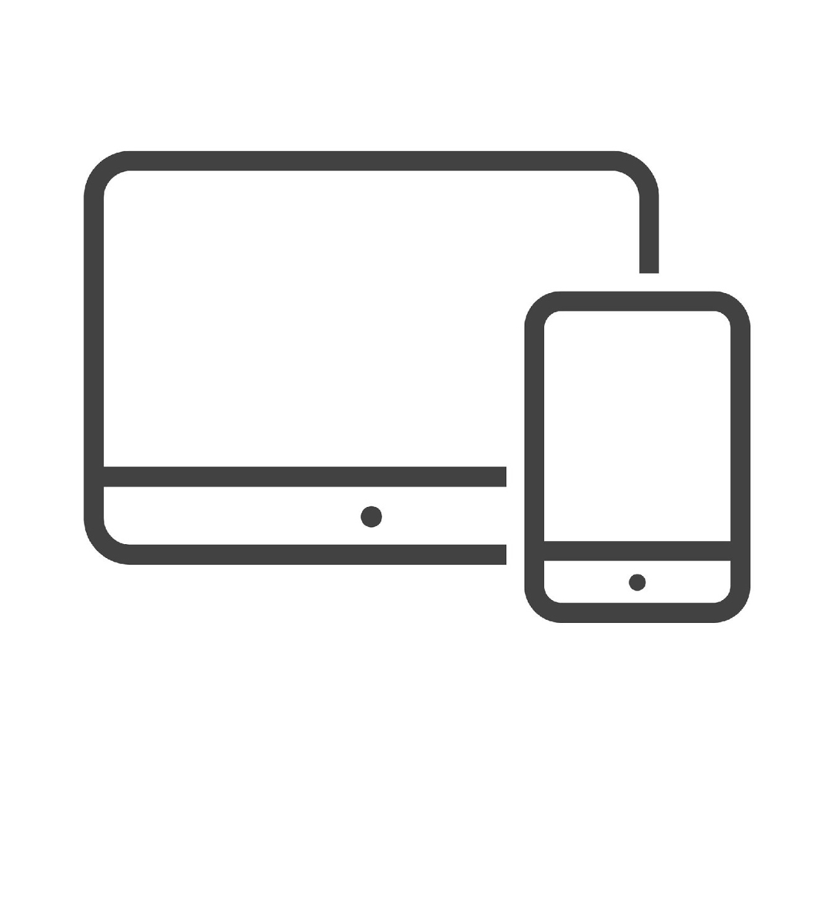
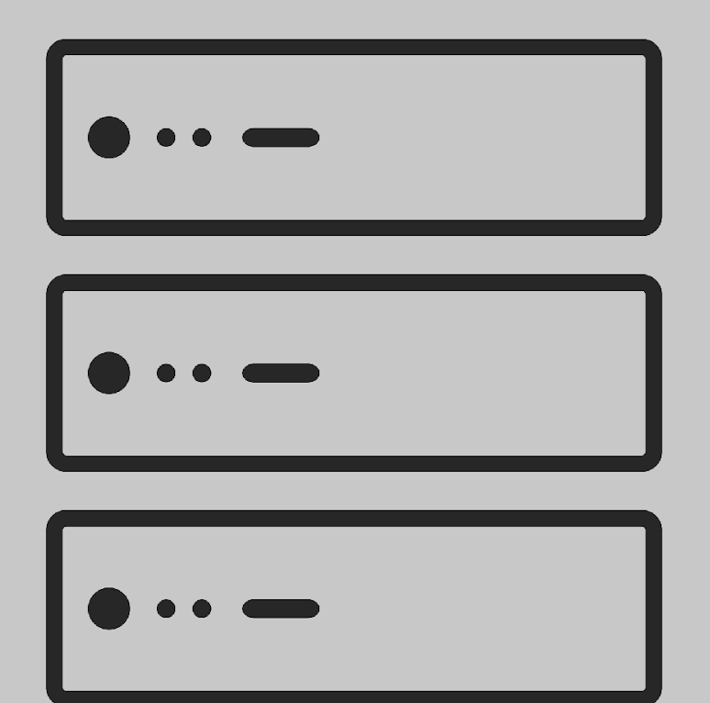


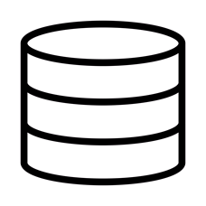
WORKING OF A WEB APPLICATION
Collect data
Request
Display results
Response
Contains app logic
PHP, JavaScript, Python, and Java
What the user sees and interacts with
HTML, CSS, and JavaScript Frontend
Users
Web server
File system
HTML, CSS, and images
Database
MySQL, PostgresSQL, and MariaDB
Backend
Web Application Architecture

Slide 10

BENEFITS OF A WEB APPLICATION
Is independent of any OS
Is secure
Reduces cost
Is scalable
Is easy to maintain
Increases overall efficiency

Slide 11
COMMONLY USED WEB APPLICATIONS
1
Google apps: Applications for work such as Google Docs, Google Sheets, and Google Slides
2
Learning platforms: Udemy, upGrad
3
E-commerce: Flipkart, Amazon
4
Booking solutions: Bookmyshow, Booking.com
5
Social media: Facebook, Twitter

Slide 12
Application Architecture

Slide 13

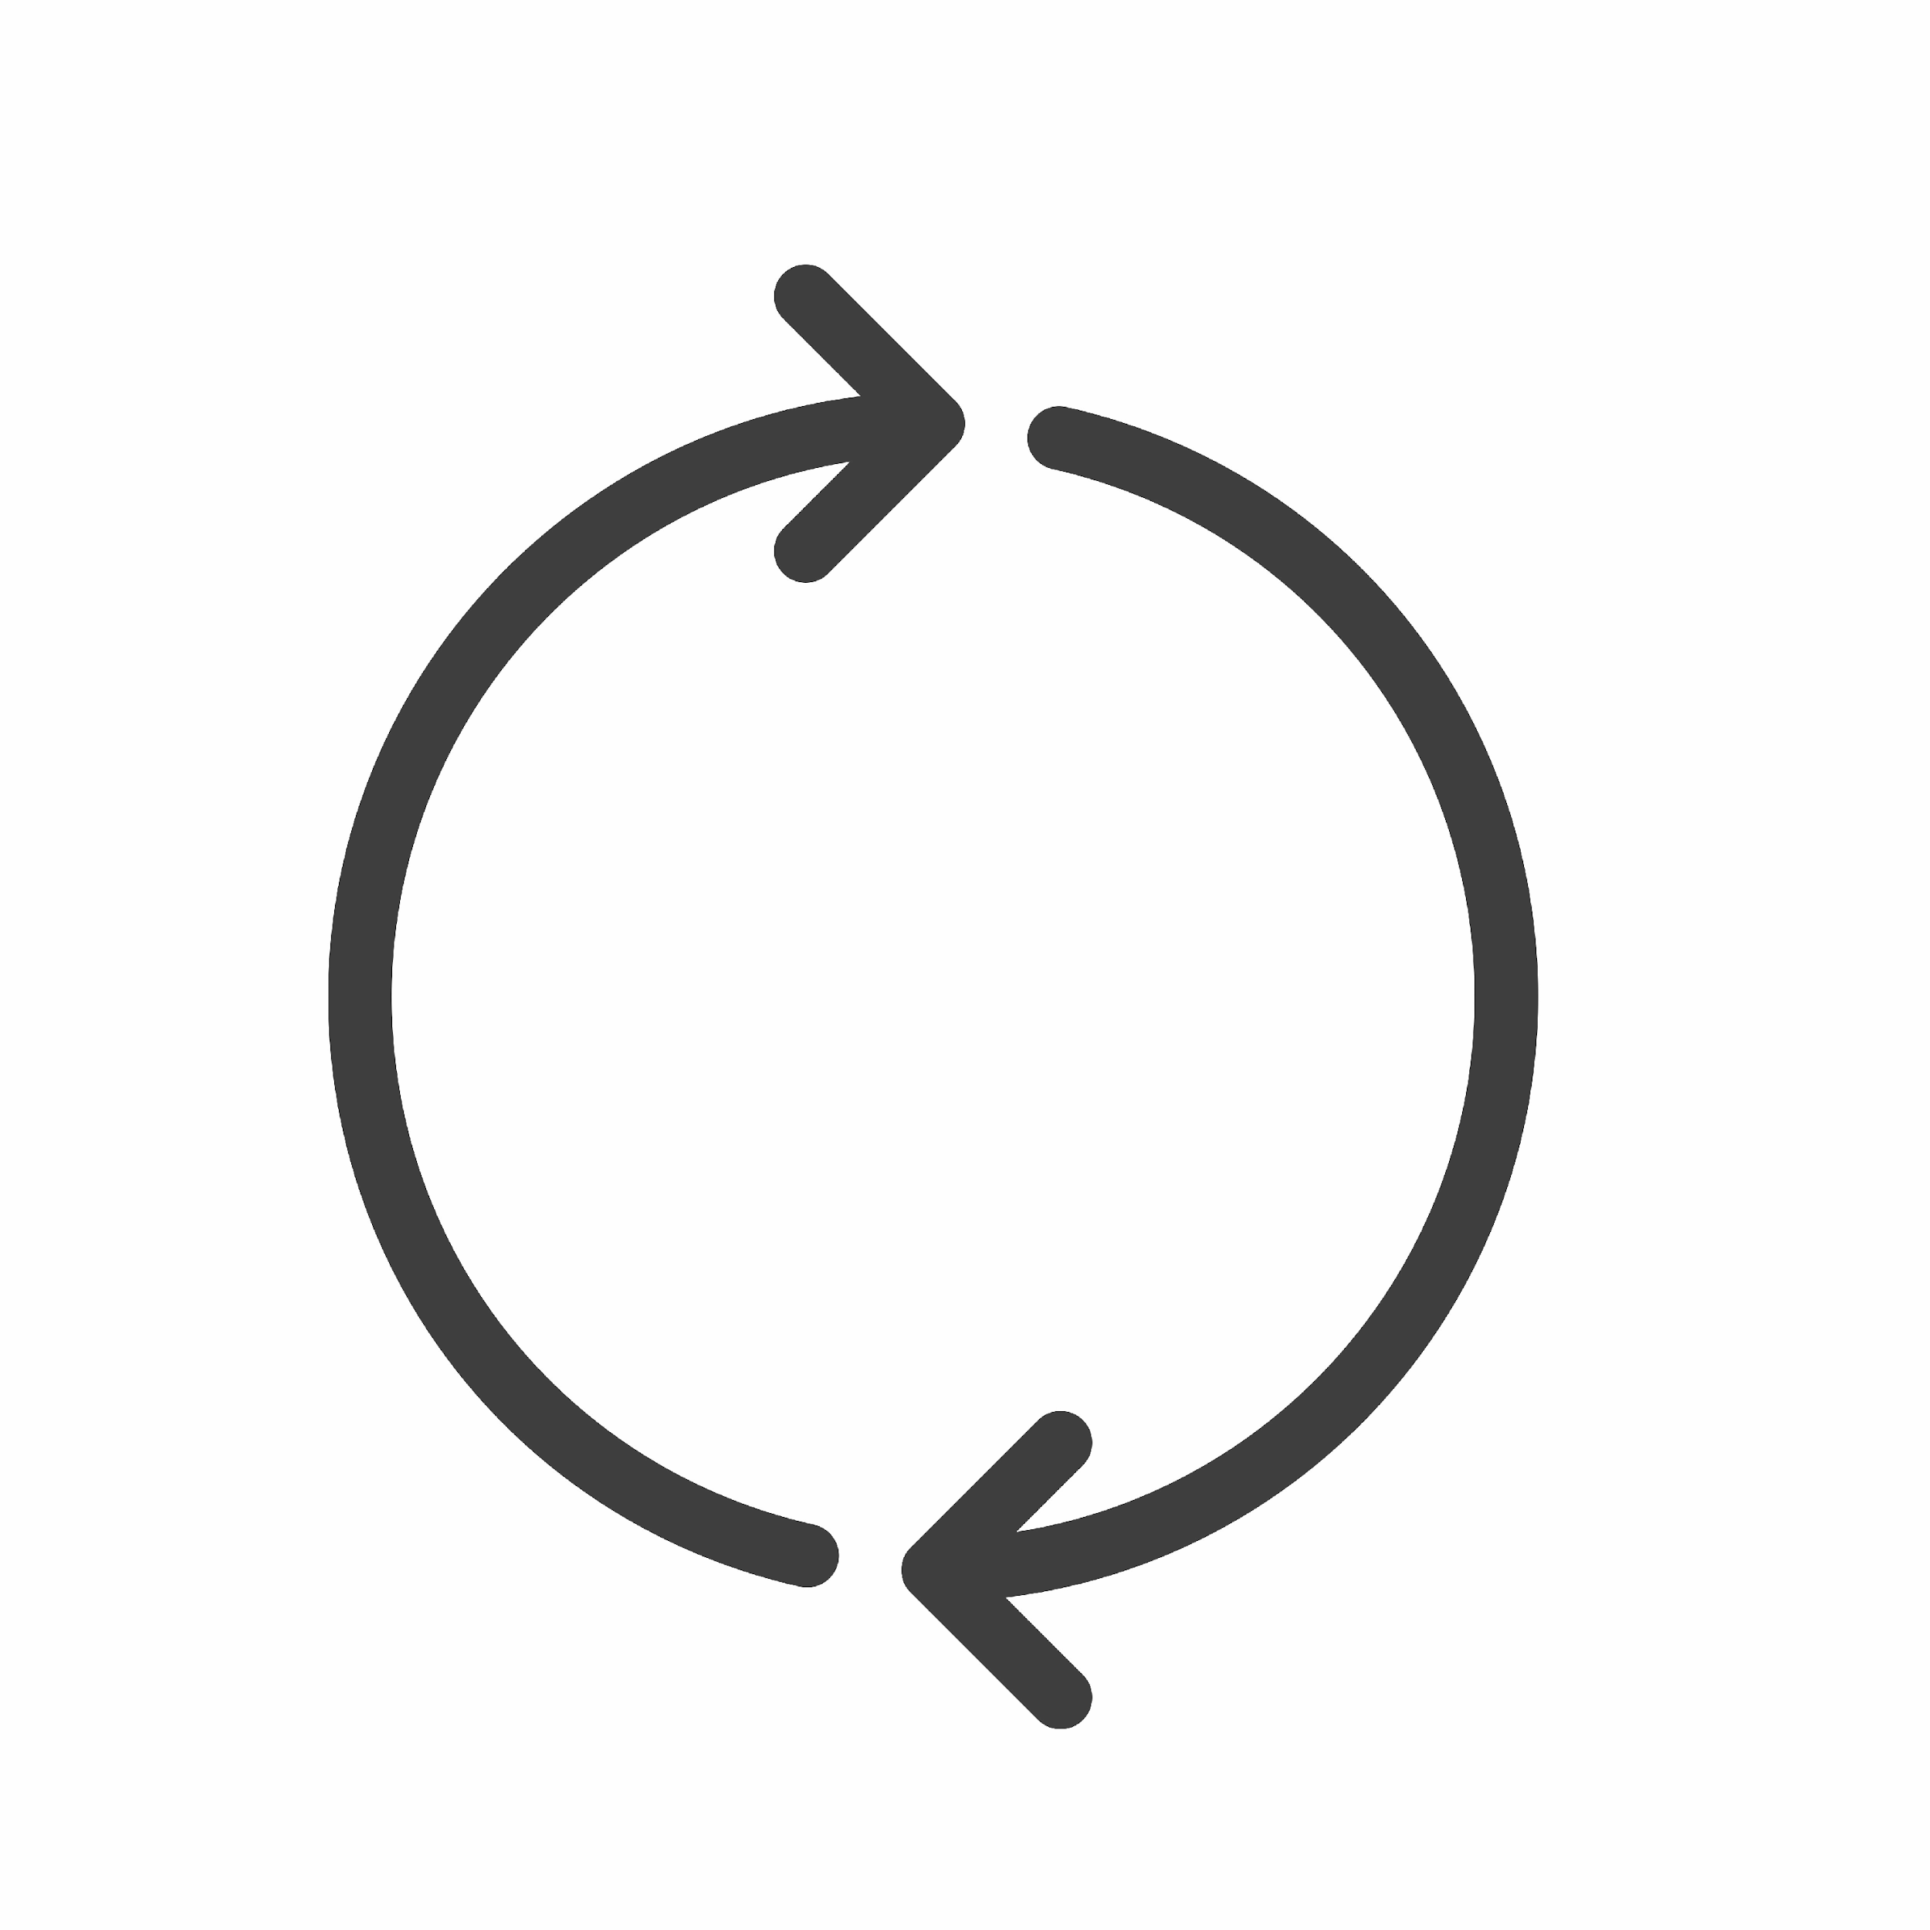
CLIENT-SERVER ARCHITECTURE
Client
Web Server
HTML
Web Construction Logic
HTML
Business Logic

Slide 14

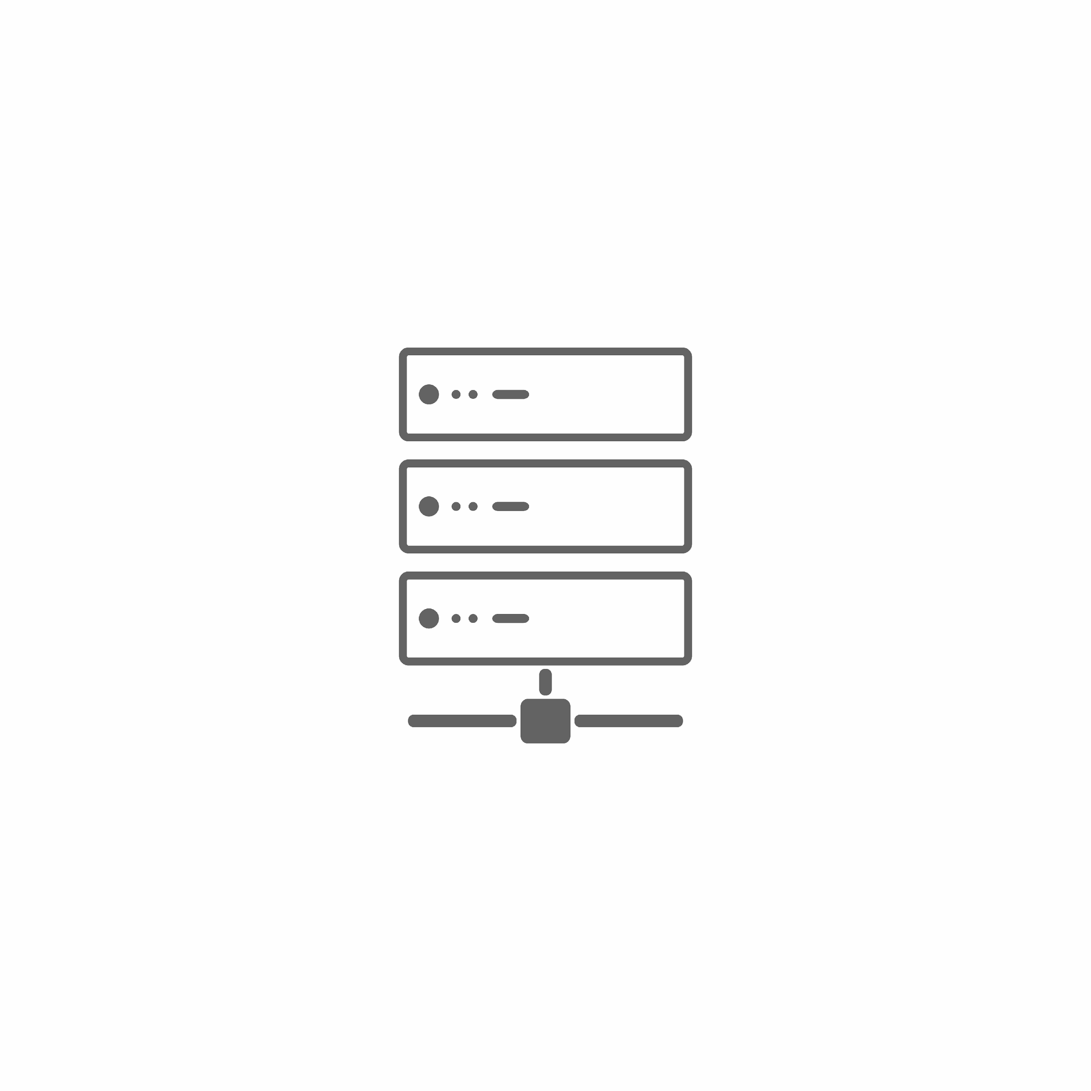


WEB APPLICATION ARCHITECTURE
Tiers
Layers
Client Tier
Business Tier
Storage Tier
Presentation Layer
Business Logic Layer
Storage Layer

Slide 15
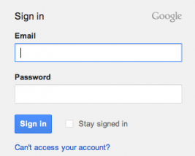
PRESENTATION LAYER
It is also called the client layer and consists of the user interface
The user interface is mostly a graphic user interface that is accessible over a web browser or any web-based application
The main functionality of the presentation layer is to communicate with the application layer. This layer passes the information inputted by the end user through keyboard inputs and mouse clicks to the application layer
This tier is often built on web technologies such as CSS, HTML5, or JavaScript
For example: Gmail login page

Slide 16

APPLICATION LAYER
It is where our core business logic resides
Let’s take our Gmail use case - When the user clicks on the sign-in/login button, the application layer interacts with the data layer and sends the required information to the presentation layer
It manages the application’s functionality by performing detailed processing of the data
It is mostly written in Java, .NET, C#, Python, C++, etc.

Slide 17
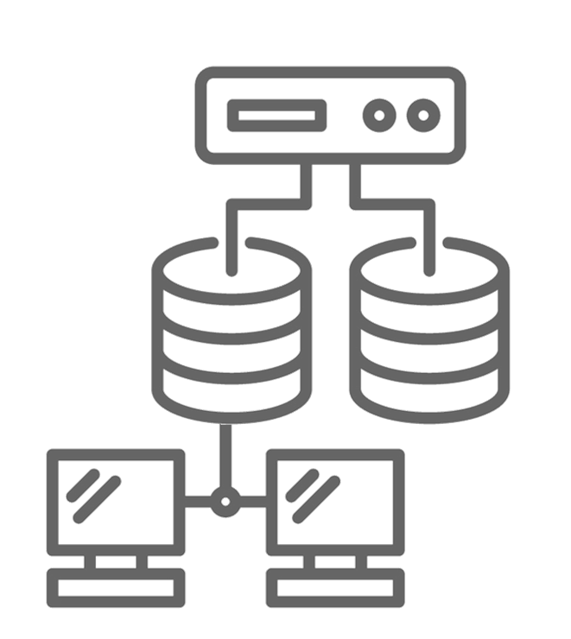
DATA LAYER
It is the data storage layer of our application
Let’s take our Gmail use case - The application layer communicates with the data layer to retrieve/store data
It contains functions that connect with the database and perform the required actions: insert, update, delete etc.
Examples of such systems are MongoDB, Oracle, MySQL, and PostgreSQL

Slide 18

EXAMPLE
A user logs into Netflix to watch a video
Once they log in, they might access a specific video through the Netflix interface, which is the presentation tier they use as an end user
Once they select a video, that information is passed on to the application tier
It then queries the data tier to call the information, in this case a video, back up to the presentation tier
This happens every time you access a video from most media sites

Slide 19


One-Tier Architecture
One-tier architecture has all the layers, such as the presentation, business, and data access layers, in a single software package
Applications that handle all three tiers, such as MP3 player and MS Office, come under one-tier architecture
Presentation Layer
Client Tier
Application Layer
Data Base Layer

Slide 20
TWO-TIER ARCHITECTURE
Client Tier
Database Tier
Client computer
Database layer

Slide 21
THREE-TIER ARCHITECTURE
Client Tier
Application Tier
Database Tier
Client computer
Application layer
DataBase layer

Slide 22
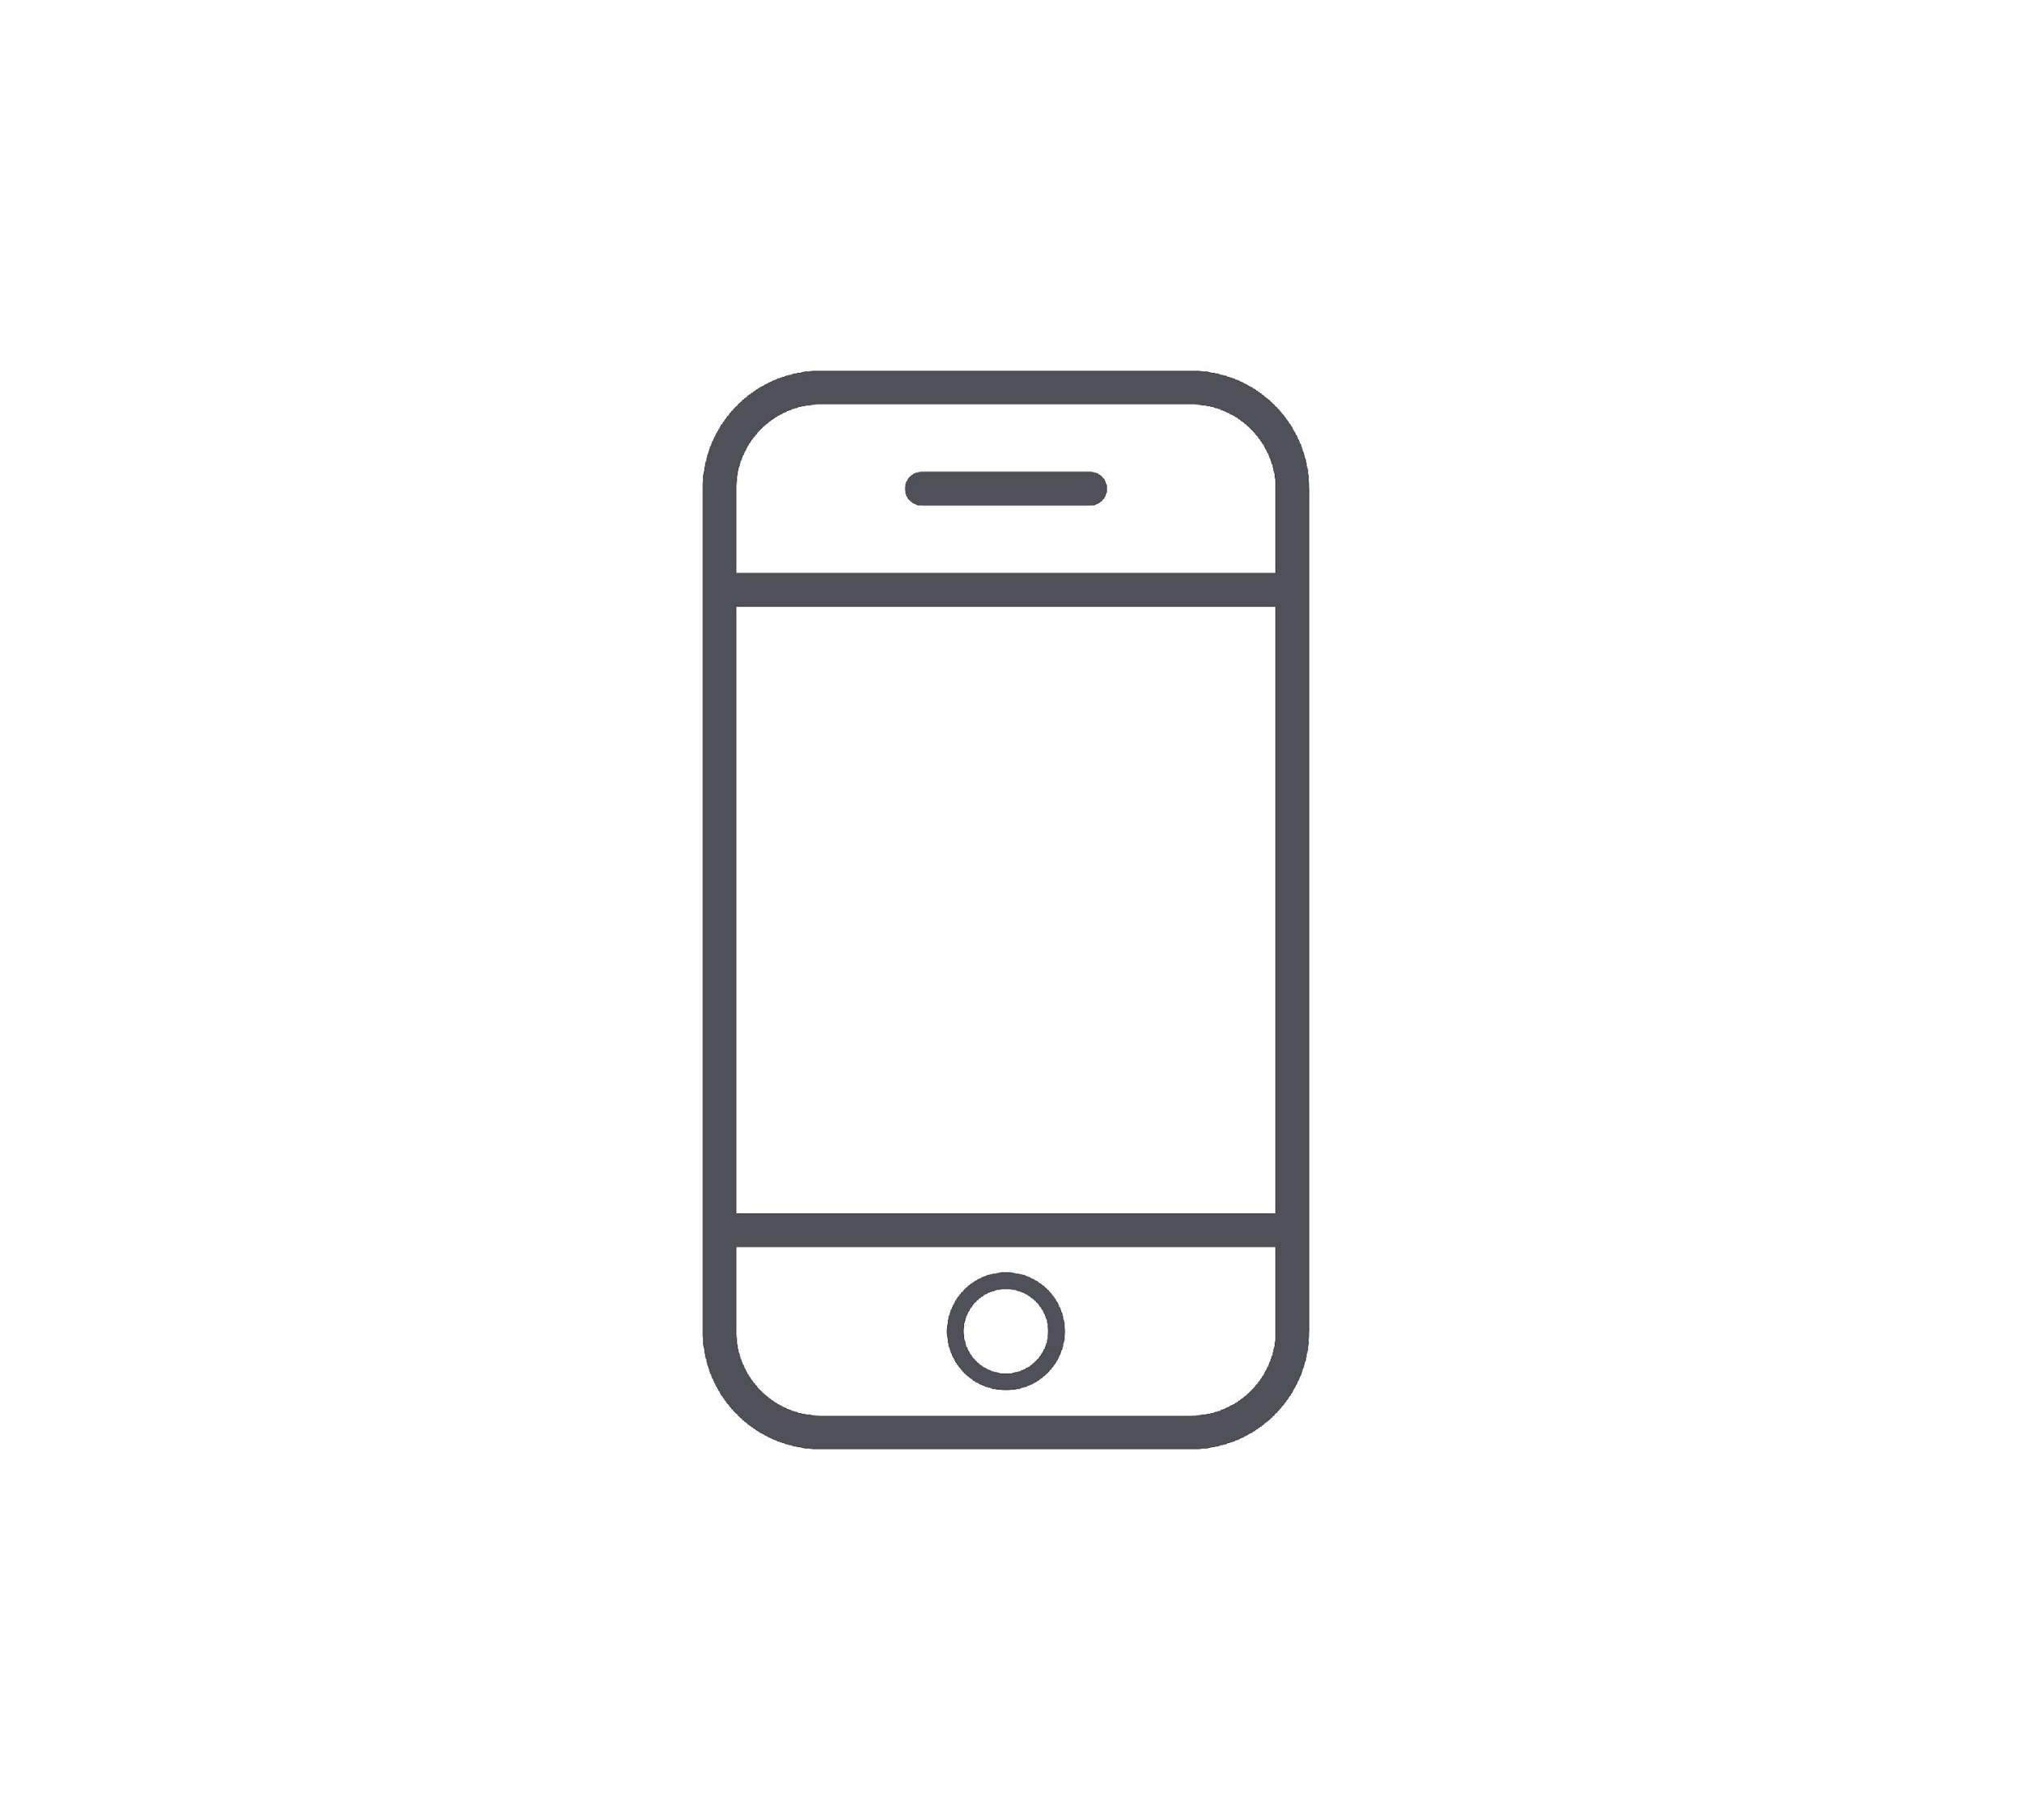
EXAMPLE: IRCTC
“Difference between 2-tier and 3-tier architecture is somewhat the same as the difference between booking a rail ticket at the counter and booking a rail ticket via IRCTC.”
Mobile Ticket
Online Reservation System
Centralized Database Server
eTicket
Traveler
Management Information System
Directory Services
i
Help Desk
Help Desk
Payment System
Accounts

Slide 23
BENEFITS OF USING A 3-LAYER ARCHITECTURE
Improved Speed of Development
Scalability
Flexibility
Availability
As an application is divided into modules, development teams can quickly enhance and develop the product
An update made to a specific layer has zero to minimal impact on other layers
A team can have groups of specialized developers for each layer
Each layer can be individually scaled as required
We can keep the application and database layers hosted onsite and have the presentation layer on a public cloud or vice versa
Disparate layers help increase reliability and availability. We can host different parts of the application on different servers and also utilize caching to speed up data access

Slide 24
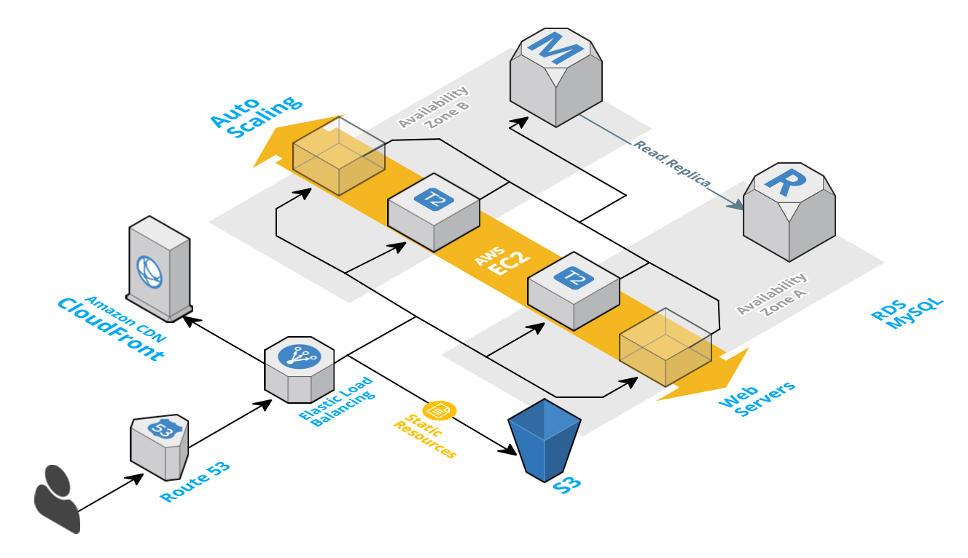
THREE-TIER INFRASTRUCTURE ON AWS

Slide 25

Now that you have learned about web servers, we will talk about the different types of web applications
Monolithic Architectures
Microservices
Web Application Architecture
Serverless Architectures

Slide 26
ARCHITECTURES OF WEB APPLICATIONS
Monolithic vs SOA vs Microservices
Monolithic
Single unit
SOA
Coarse-grained
Microservices
Fine-grained

Slide 27
MONOLITHIC ARCHITECTURE
Presentation Layer
Monolith means all in one piece. It is a single-unit setup
All the features of a project/layer exists in a single codebase
Example:
Consider an e-commerce application. The application contains several components such as a web interface and a backend processing service to check the inventory, authorize and charge payments, and place an order
In this case, if we deploy the application as a single “war” file, it will be called monolithic architecture
Service Layer
Persistence Layer
DB
Monolithic Architecture

Slide 28
MONOLITHIC ARCHITECTURE
Advantages
Drawbacks
Easy to deploy
Easy to test
Easy to scale horizontally
Easy to develop
Maintenance
Size of application likely to be a bottleneck
Need to redeploy the entire application in each update
Reliable
Not so easy to adopt new technologies

Slide 29

SERVICE-ORIENTED ARCHITECTURE
User
Service-oriented architecture (SOA) is based on the principle of “service provider” and “service consumer”
In SOA, instead of having a single monolithic unit/system/component, we have many different units/systems/components talking to one another
Each component is called a “web service” and can either be a “service provider” or a “service consumer”
Example: Let’s say we wish to create an e-commerce website. We can use Google services for authentication and PayPal services for payment. Our main task is creating a common process and integrating all the external services
Machine M1
Machine M2
Front End
Back End
Consumer
(Service call)
Provider
Consumer
Machine 3
Machine 4
Data Access Layer
DB
Provider
Consumer
Provider

Slide 30
SERVICE-ORIENTED ARCHITECTURE
Advantages
Disadvantages
Service reusability
Easy maintenance
Platform independent
Availability
High overheads
High investment
Complex service management

Slide 31
Microservice
MICROSERVICE ARCHITECTURE
Microservice
In this architecture, we break down a monolithic application into smaller, independent units
Each individual module communicates within each other using a well-defined method called APIs
The principles underlying microservices are as follows:
Individual responsibility
Designed keeping failure in mind
Built around the new and available business capabilities
Microservice
Microservice
Microservice
DB
DB
DB

Slide 32
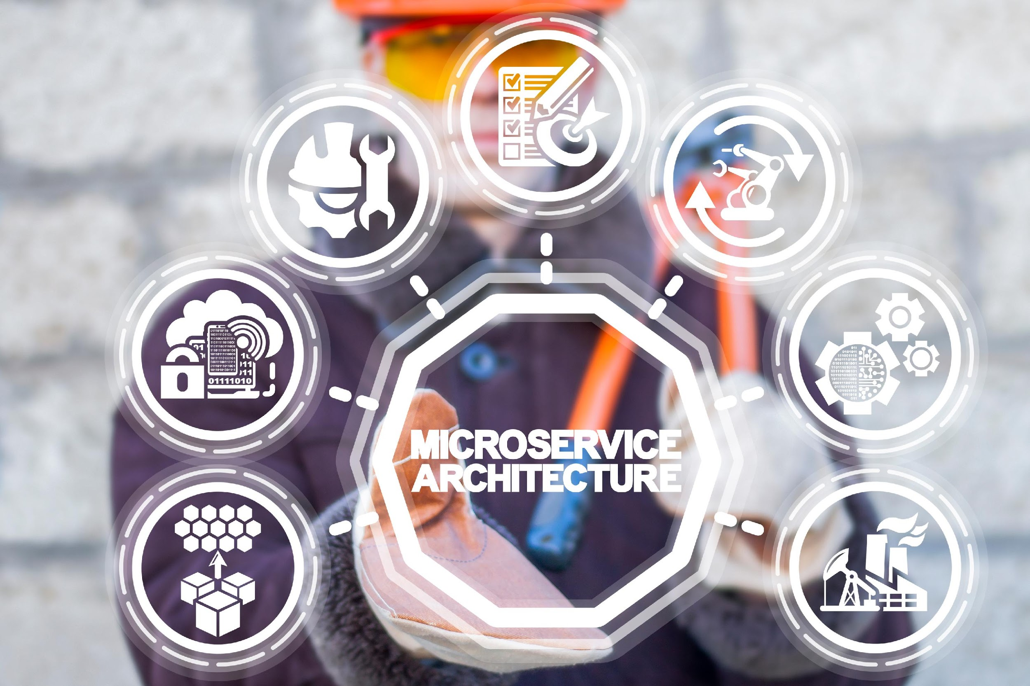
MICROSERVICE ARCHITECTURE
Advantages
Microservices are self-contained, independent deployment modules
The cost of scaling is relatively lower than the monolithic architecture
Microservices are independently manageable services. It can enable more and more services as the need arises and can minimizes the impact on existing service
It is possible to vary or upgrade each service individually instead of upgrading the entire application
Microservices permit us to develop an application that is organic (an application that later upgrades by adding more functions or modules) in nature

Slide 33
MICROSERVICE ARCHITECTURE
Advantages
It enables event-streaming technology to allow easy integration as compared to heavyweight interprocess communication
Microservices follow the single responsibility principle
The demanding service is often deployed on multiple servers to improve performance
Less dependency and easy to test
Dynamic scaling
Faster release cycle

Slide 34




MICROSERVICE ARCHITECTURE
Disadvantages
Microservices have all the associated complexities of a distributed system
There is a higher possibility of failure throughout communication between totally different services
It is difficult to manage a higher number of services
The developer must solve the problems such as network latency and load balancing
Complex testing over a distributed environment

Slide 35
DIFFERENCE
Key | Monolithic Architecture | Microservices Architecture
Basic | It is built as one large system and has a single codebase framework | Microservices architecture is made up of small independent modules based on business functionality
Scale | It cannot be scaled easily based on increases in demand | It can be scaled easily based on increases in demand
Database | It has a shared database | In most cases, modules have their own databases
Deployment | A single and massive codebase makes development slow and time consuming | Since each project is independent and small, overall time required for building and development is less
Tightly coupled and loosely coupled | It is extremely difficult to vary the technology, language, or framework because everything is tightly coupled and interdependent | It is easy to vary the technology or framework, as every module and project is independent

Slide 36
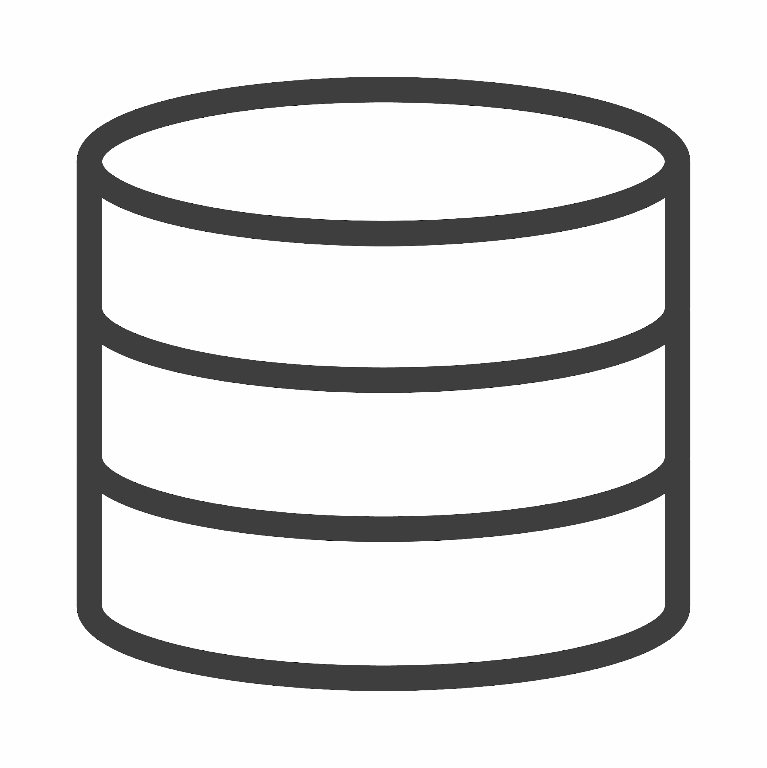

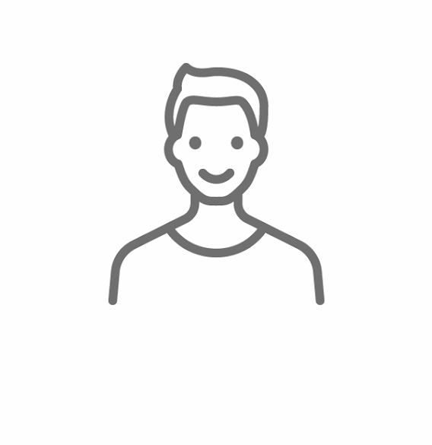
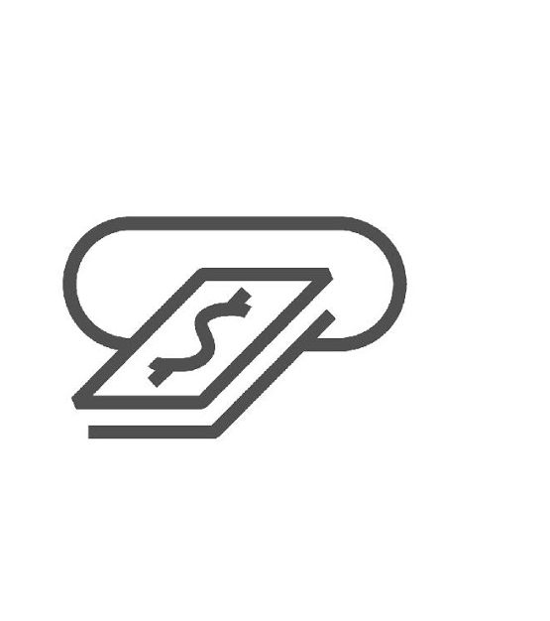



USE CASE: UBER
Database
Initially a global taxi technology company
Started its journey with monolithic architecture; one codebase, which was the core business logic
Single codebase to manage user info, driver info, notifications, logins, etc.
Faced issues with scalability and continuous integration as it expanded across the globe
Rest API
Adapter 1
Browser
Adapter 2
Adapter 3

Slide 37

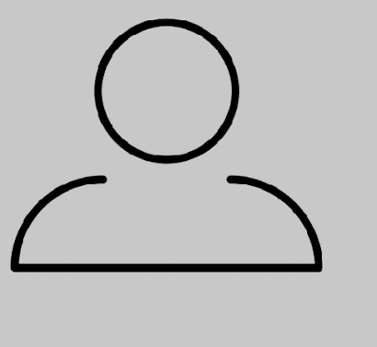
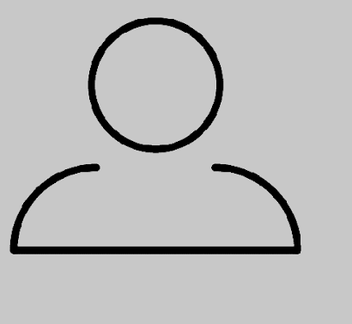
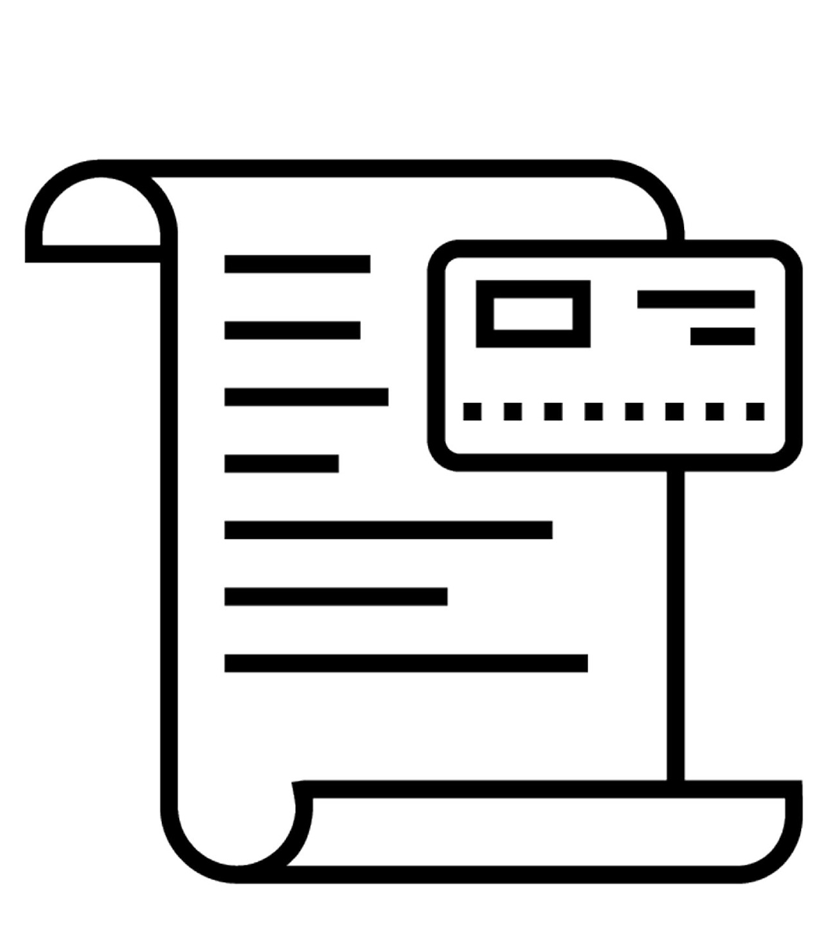

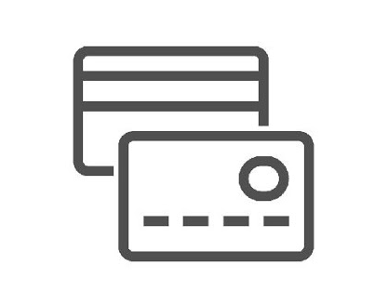
USE CASE: UBER
To solve this, it adopted the microservices approach
The architecture was divided into smaller units, and each unit used REST APIs for inter-communication
The API gateway is used to connect the driver with all the passengers
All the internal points are connected to the API gateways
If a developer wants to update the driver web UI, they just have to update/deploy the new driver UI microservice
API
Gateway
Passenger
Management
Billing
Adapter 1
Rest API
Rest API
Passenger
Web UI
Driver Management
Payments
Rest API
Rest API
Adapter 2
Driver
Web UI
Trip Management
Notification
Rest API
Rest API
Adapter 3

Slide 38

MICROSERVICE TOOLS
Message queuing: Apache Kafka, AWS SQS
Containerization: Docker
Orchestration: ECS , Kubernetes
Cloud deployment: AWS , GCP, Azure
Application monitoring: Prometheus
API Testing and management: Postman, API Fortress

Slide 39
MESSAGING
In microservices, we have autonomous services
To get the application running, they have to communicate with each other. To achieve this, multiple tools are available in the industry
For example: Apache Kafka, RabbitMQ, and SNS
Apache Kafka: It is a distributed pub-sub messaging system. It was originally developed at LinkedIn. It is agile, scalable, and distributed by design
SNS: Simple Notification Service is an AWS offering. It is a reliable, robust, and flexible choice for microservice communications

Slide 40
Containerization Applications
Containerization
Containerization is the process of building an application along with all its required dependencies and configuration files so that it can be run on any computing environment efficiently
Docker is an open platform for running and developing applications
Docker is the most common tool used in the industry to build containers
App A
App B
App C
App D
App E
App F
Docker
Host Operating System
Infrastructure

Slide 41
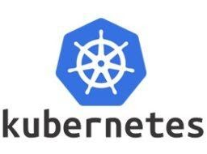
Orchestration
It is the method of automating most of the manual work required to run containers in a production workload
Tasks such as scaling (up or down), networking, load balancing and many more are managed by container orchestration tools
Example: Kubernetes
It is the most common open-source container orchestration tool
At present, it is the industry standard in terms of container orchestration
It was built upon 10+ years of experience of running production workloads at Google, along with the best ideas and practices from the community

Slide 42
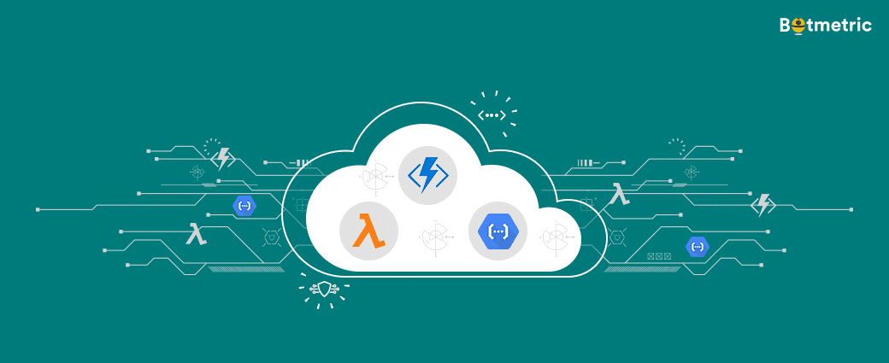
Serverless Architecture
This involves building and running an application without involving the backend servers
Servers are managed by the cloud providers, and they take care of its allocation and provisioning
The application is broken into smaller functions that must be invoked for it to work
Examples: AWS Lambda, Azure Functions, and Google Cloud Functions
"We relied on AWS Lambda to get our platform on the market in under four weeks. Within six months, we had scaled to 40,000 users without running a single server.” - Sam Kroonenburg, co-founder and CEO, A Cloud Guru

Slide 43
Scaling and Load Balancing

Slide 44
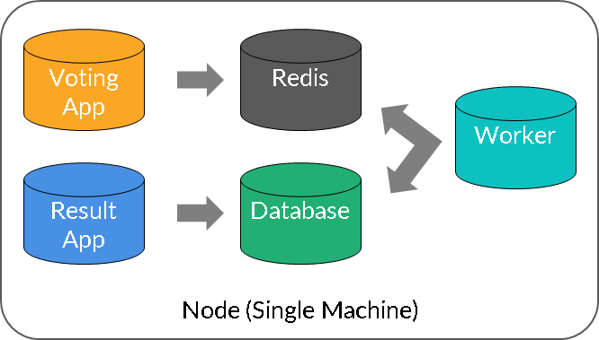
VOTING APPLICATION

Slide 45
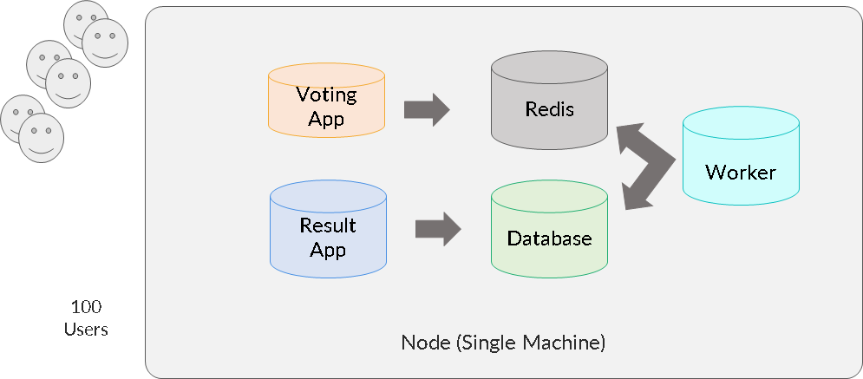
SCALING

Slide 46
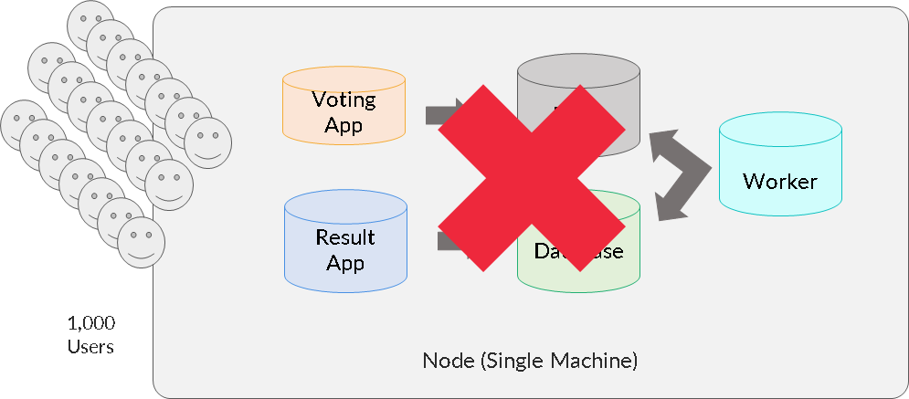
SCALING

Slide 47
SCALING
Scalability is the ability to easily increase or decrease compute or storage resources as needed to meet changing demand cost-effectively
Ideally, if your app takes t seconds to respond to a user request, it should take the same t seconds to respond to each of the million concurrent user requests on your app
The cloud has dramatically simplified all these scaling problems
Remember, scaling is important for all the parts of an application. Ignoring any part can result in downtime

Slide 48
SCALING STRATEGIES
Vertical Scaling
  Adding resources to existing servers
  Replacing a server with a bigger/more powerful server
  Example: Changing t2.small to t2.large in AWS
Horizontal Scaling
  Provision of additional servers to meet the need
  Execute the concurrent workload and handle traffic efficiently
  Example: Adding 2 more nodes in a cluster of 3 nodes

Slide 49
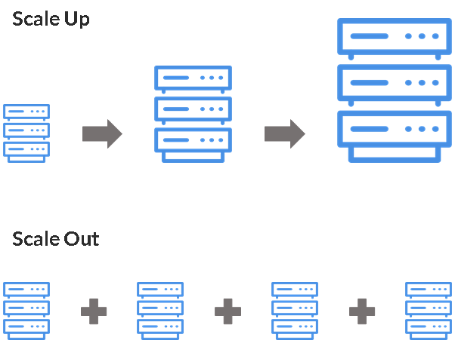
SCALING STRATEGIES

Slide 50
SCALING: USE CASES
  Vertical
    When data is on a single machine and partitioning is complicated
    Resources perform some cron job operations and duplicacy can lead to errors
  Horizontal
    It can provide instant and continuous availability
    There is no limit to the hardware capacity
    It is applicable when having multiple machines does not cause data duplicacy errors
    Run only the required hardware and choose not to pay for full capacity every time

Slide 51
SCALING: PROS AND CONS
  Vertical
    Less administrative efforts, as you need to manage just one system
    Involves downtime
    Hardware always runs at full capacity
    Finite scope for upgradeability in the future
  Horizontal
    No downtime; dynamic increase or decrease in the resources
    Choice to run only a specific quantity of hardware
    Easier to run fault-tolerance
    Infinite scope for scaling
    Architectural design likely to become highly complicated

Slide 52
WAYS TO SCALE
Manual
  Manual efforts required for scaling operations
  Not ideal for sudden fluctuations
  Can lead to human errors
Scheduled
  For predictable workloads
  Effective for non-production systems or predictable production traffic
  Example: Shut-down of non-production environments in the night hours
  Cost-effective
Automatic
  Based on predefined rules and thresholds
  Makes an application always available
  Must be configured in dynamic traffic applications

Slide 53
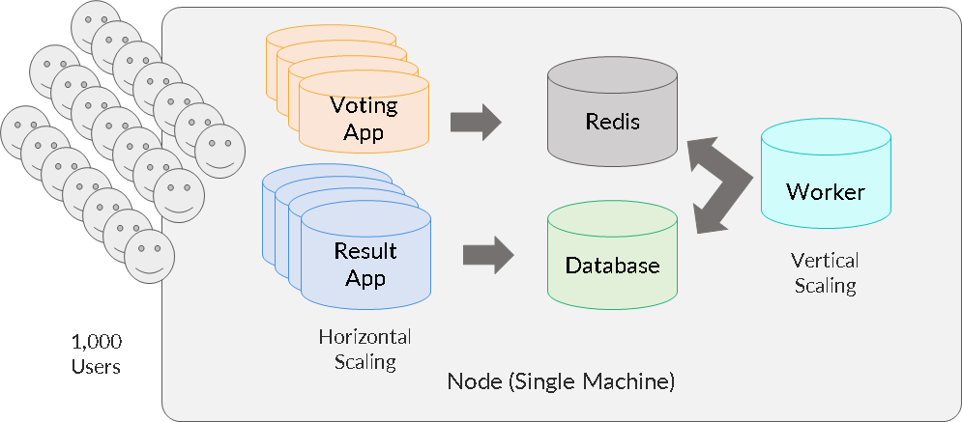
SCALING: WHAT DO WE ACHIEVE?

Slide 54
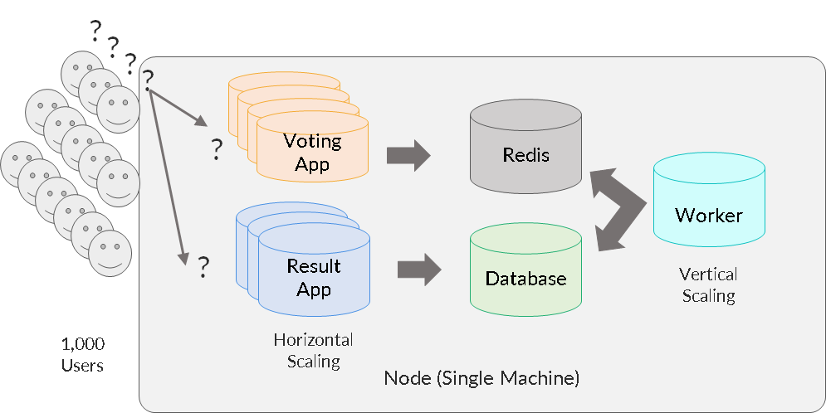
LOAD BALANCING (LB)

Slide 55
LOAD BALANCING (LB)
Load balancing refers to efficiently distributing application requests across all the healthy back-end servers
It is the key component of highly available infrastructure
It provides the flexibility to add or remove servers as per demand
The user accesses the LB, which forwards the user’s request to a back-end server
It saves us from launching any application server in a public subnet. Only the LB needs to be launched in a public subnet
It ensures the effective use of all the available servers
It saves cost

Slide 56
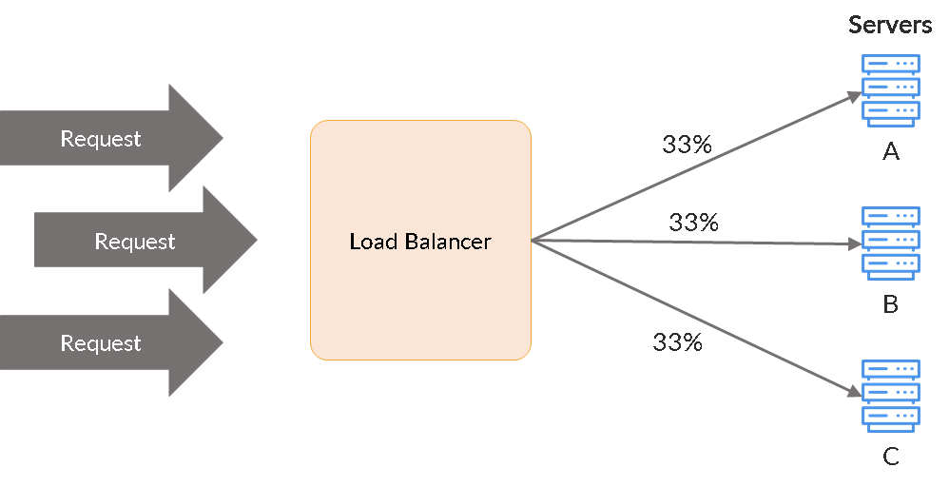
LOAD BALANCING (LB)

Slide 57
LOAD BALANCING TYPES
Round robin: This is the most common type and is widely used. Requests are distributed sequentially (one by one to each server)
Least connections: The server with the fewest connections is awarded the new request
Least time: It depends on the fastest response time and the fewest active connections
IP hash: This is used for sticky sessions. The IP address of the client is used to determine which server receives the request

Slide 58
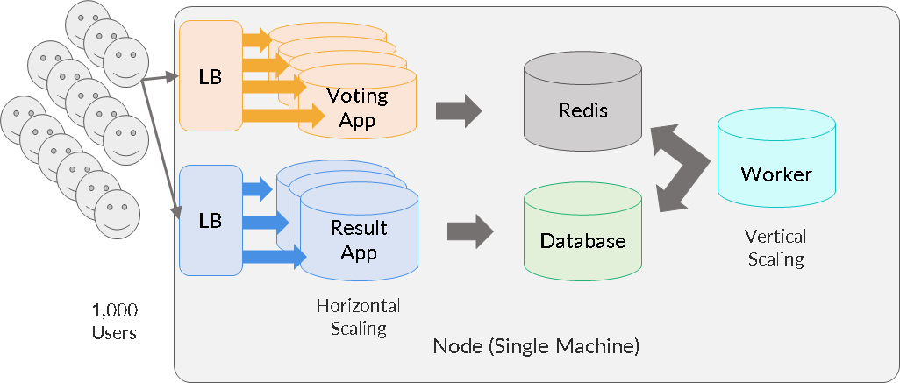
LOAD BALANCING: WHAT DO WE ACHIEVE?

Slide 59
MODULE SUMMARY
Web Application on the Cloud
06
What is a web application? How does it work?
01
Delivery models offered by Cloud
07
02
Three-tier structure of a web application
Cloud Providers: AWS, Google Cloud,etc;
08
03
Architectures of a web application
Why AWS?
09
Components of a web application
04
Amazon EC2 and its benefits
10
Scaling and load balancing
05
How to deploy a Web Application on Cloud?

Slide 60
Doubt Clearance Window

Slide 61
Tasks to complete after today’s session
MCQs
Conceptual Questions
Project Checkpoint

Slide 62
Thank You!

